Slide 1
Argumentative Essay Skills
5.a. Articulate a defensible claim/thesis
5.b. Support the argument using relevant evidence
5.c. Use reasoning to organize and analyze evidence, explaining its significance to justify the claim or thesis
5.d. Use refutation, concession, or rebuttal in responding to opposing or alternate perspectives
AP U.S. Government & Politics Course Description
“The goal is for students to construct a clear, rhetorically sound argument that supports an assertion with convincing evidence, using a structure that advances the argument
logically and persuasively.”
AP English Language &
Composition Course Description

Slide 2
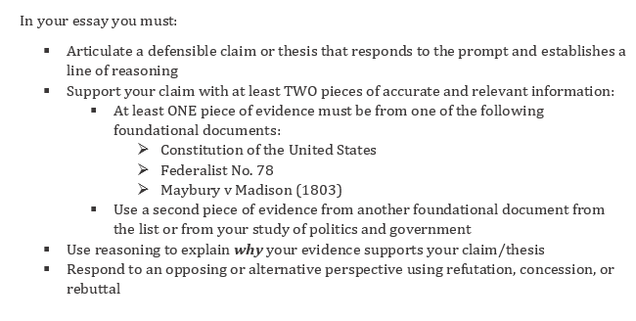
The Exam...

Slide 3
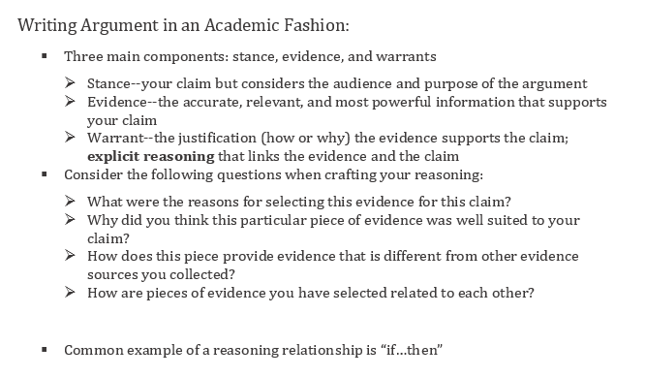
The Exam...

Slide 4
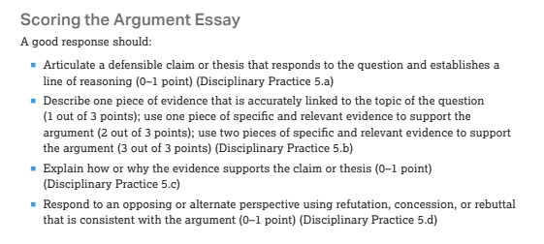
The Exam...

Slide 5
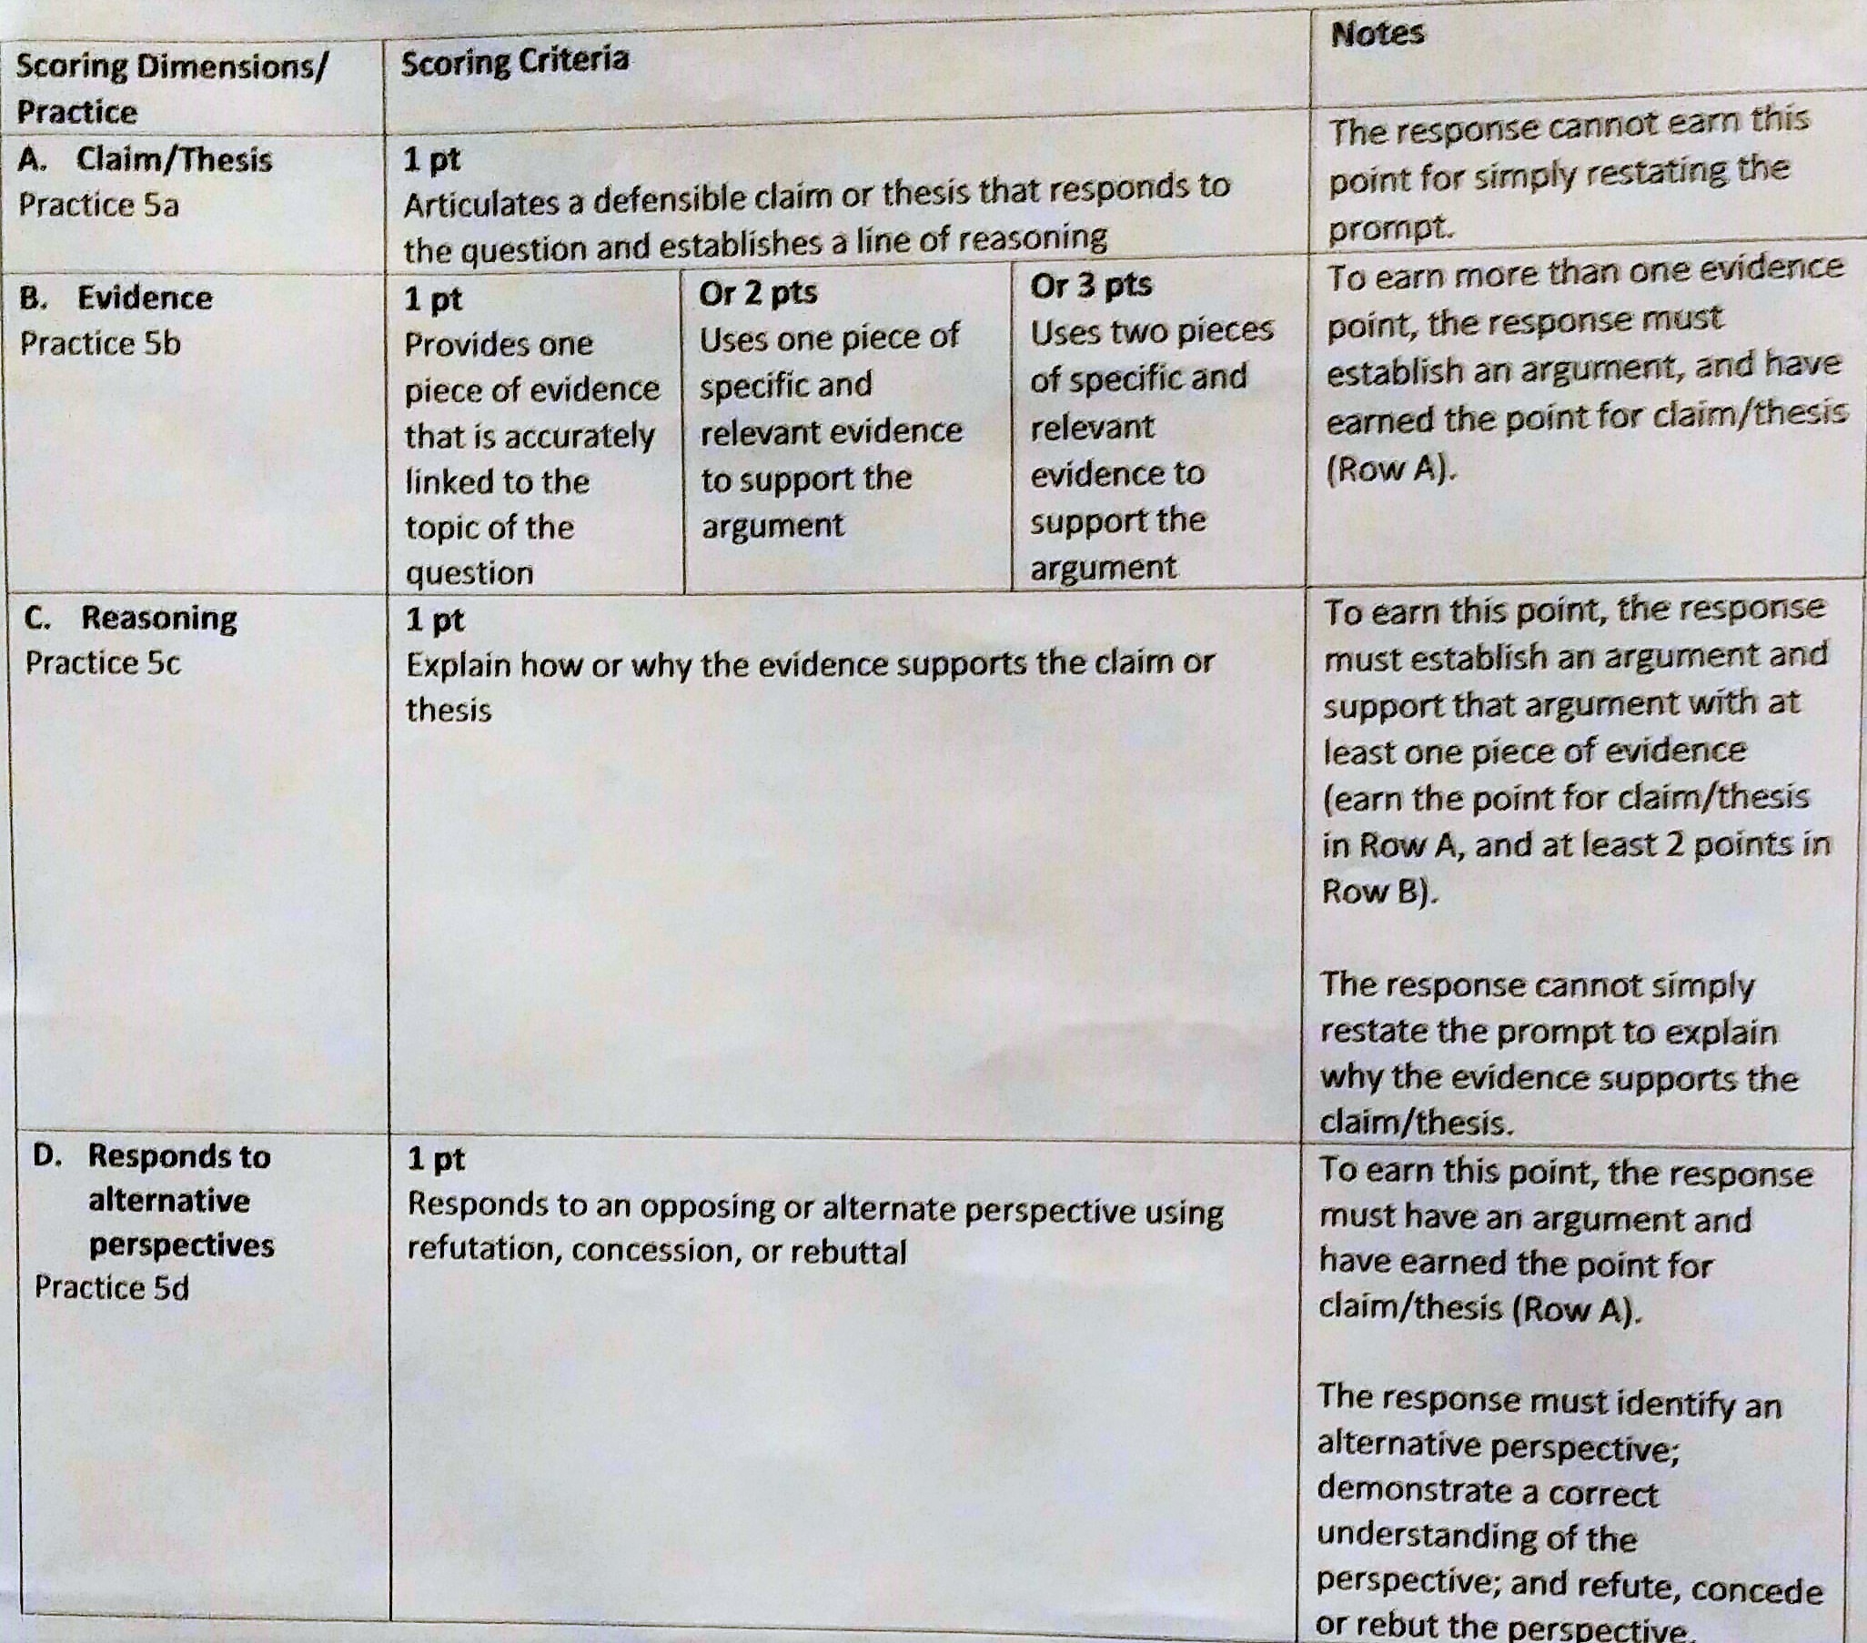
The Exam...
SCORING CRITERIA

Slide 6
Argumentative Skills Rubric
Claim/Thesis
responds to prompt
establishes line of reasoning
Does NOT simply restate prompt (requires new concept point)
Support with evidence
Describe specific evidence
Accurately linked to topic
Explain evidence significance
connect evidence to topic claim
“how” or “why” to prove argument from claim
Respond to opposing/alternate view
IDENTIFY alternative view
demonstrate understanding of alternative view
refutation, concession, rebuttal consistent with claim/argument
Claim/Thesis
Support with evidence
Explain evidence significance
Respond to opposing/alternate view

Slide 7
Grading Rubric
SKILLS | Definite Point | Possible Point | No Point
Claim/Thesis | Responds to prompt Establishes arguable claim/thesis Clear line of reasoning with specific point(s) | Responds to prompt | Restates prompt
Support Evidence | DESCRIBE specific evidence Accurately links to topic claim | Describes specific evidence | Gives general evidence Has no argument
Evidence Significance | Connects evidence to topic claim EXPLAIN “how” or “why” evidence proves topic claim Elaborates on evidence beyond quotes | Connects evidence to topic claim | Restates prompt or claim to explain evidence
Response to alternate view | IDENTIFY other view is valid Show weakness/incorrect part Explain why author’s claim is stronger | Identify other view | Has no alternate view
Claim/Thesis
Support with evidence
Explain evidence significance
Respond to opposing/alternate view

Slide 8
