Slide 1
Welcome Class of 2027!
#ProudToBeABengal
Materials due 3/3

Slide 2
Required Paperwork: Attendance area determines what you need!
HMS/HHS attendance boundary
Out-of-district students
CRA/CHS attendance boundary
Outliers/unique situations

Slide 3
HMS Students (HHS Attendance Boundary)
Yellow HHS registration form
Blue health history
Jodi Neary 324-2214

Slide 4
Out-of-District Students (EVMS, Jefferson County and Broadwater County)
Refer to out-of-district checklist.
Out-of-district form requires supporting documentation.
Tuition ($175). Checks are not required at this time.

Slide 5
CHS/CRA Attendance Area
In-district transfer request
Approval by Brett Zanto, CHS Principal
Approval by Steve Thennis, HHS Principal
Yellow HHS registration form
Blue health history

Slide 6
Outliers or Unique Situations
Students who live in the HHS attendance boundary but attend EVMS or Montana City or Clancy:
Yellow HHS registration form
Blue health history
HSD Enrollment Form
Request for Records

Slide 7
Why Helena High?
Advanced Academic Options (AP and Dual Credit)
Variety of Elective Opportunities
Experiential and Work-Based Learning
Clubs and Activities

Slide 8
Why Helena High?
Talented educators and staff

Slide 9
Why Helena High? This guy! We love Mr. Thennis!

Slide 10
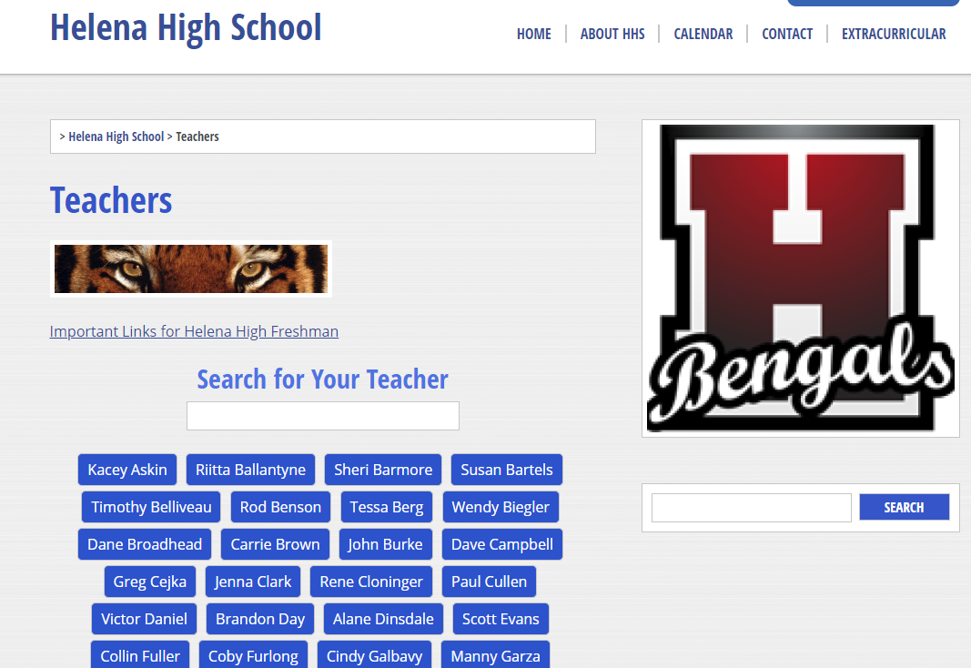
Resources
HHS Web Page hhs.helenaschools.org
Teacher and Dept. Pages
Extracurricular and camps
Counseling Department
HHS Counseling Facebook or Instagram
Call 324-2220
HHS App

Slide 11
Transportation:

Slide 12
A student’s perspective on Helena High:
“There is something for everyone.”

