Slide 1
Welcome to Helena High Science! 2024-2025

Slide 2
Overview
Helena High School Science Team’s goal is to prepare students to be College and Career Ready and to gain interest in Science. Here at Helena High, we strive to make Science interesting and meaningful to your everyday life and we want you to explore as many courses as you can.

Slide 3
Science Graduation Credits
Science Graduation Requirements are 2 years (2 credits) of science
(1 Physical Science + 1 Life Science)
3 years of science is recommended for most colleges/universities.
HHS Science Teachers believe that more science credits will better prepare you for college and your career.

Slide 4
Science Course Offerings
9th Grade | Earth and Space Science or Honors Earth and Space Science
10th Grade | Biology or AP Biology and Chemistry
11th Grade | Chemistry Physics AP Environmental Science Biology II AP Chemistry
12th Grade | Chemistry Physics AP Environmental Science Biology II AP Chemistry Science Seminar

Slide 5
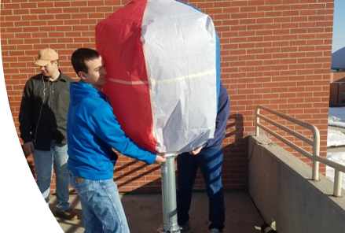
Science Electives
Advanced Placement Electives
AP Environmental Science
AP Chemistry
AP Biology
Physics
Biology II
Chemistry

Slide 6
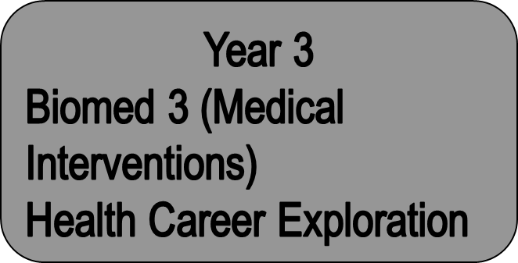
Health Career Pathway

Slide 7
Science Clubs and Events
Science Club
Envirothon – team science competition in the natural resources.
Science Bowl – team science competition in trivia format.
Science Olympiad – team competition with a variety of events hosted by Montana State University.
Outdoor Club
Get outside with Helena High School students by rock-climbing, hiking, playing frisbee golf.

