Slide 1
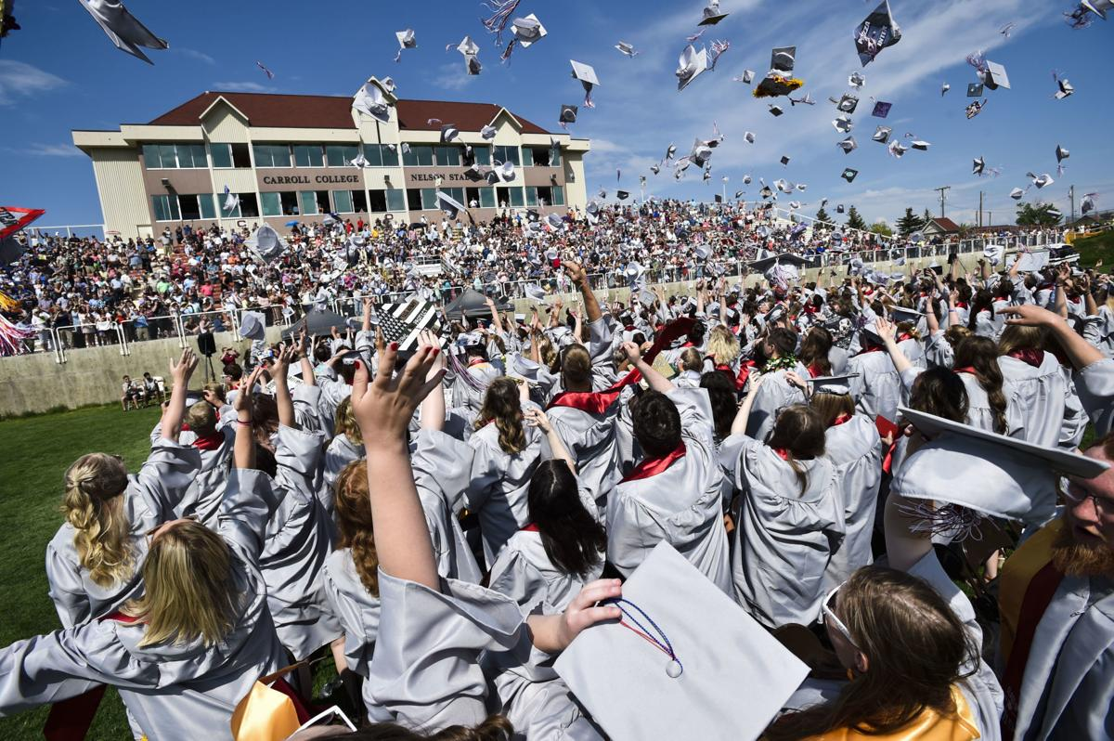
Senior Year: 101

Slide 2
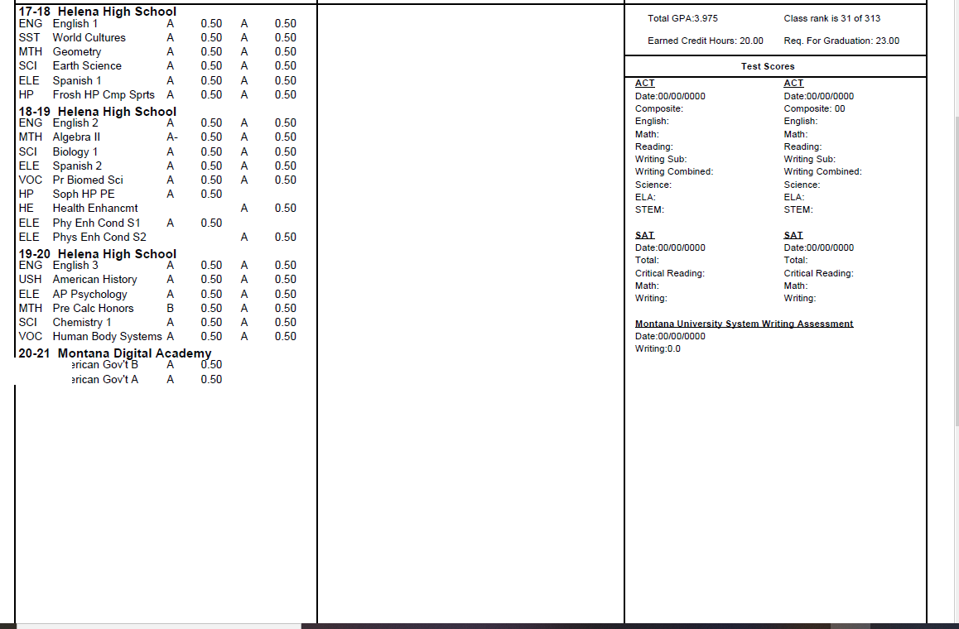

Slide 3
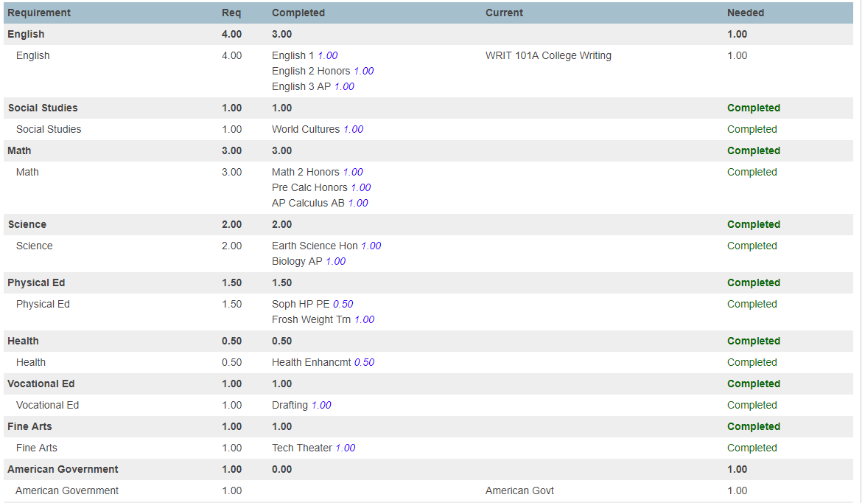

Slide 4

Parchment.com
Third-party vendor used by Helena High.
Free to students.
Create an account in order to request transcripts for colleges, military, and scholarships.

Slide 5
Is your NAME correct on your transcript?
Does it match your driver’s license/birth certificate?
The name on your transcript will be on your diploma.

Slide 6

College Fair:
September 23, 2024
Carroll College 1:30-3:30
Click here to Register Online to Participate

Slide 7

College Application Week
September 30 - October 11th, 2024
Periods 6-7 (September 30 - October 4th)
HHS Black Lab
By appointment (October 7th-11th)
Get assistance with college admissions applications.
Use the Montana University System Application

Slide 8

FAFSA
(Free Application for Federal Student Aid)
Why FAFSA?
This is how you get a student loan or grant.
Required for certain scholarship applications.
Need Help?
Text FAFSAHELP to 41411
Step One: Create a FAFSA ID. The student and one parent/guardian will need a username and password.
Step Two: Complete the FAFSA application online.
Important Dates: December 1st- FAFSA app.
File by February 1st.
Click here to access the FAFSA site.

Slide 9
Scholarships
(2-year, 4-year, trade schools, and special programs)
Helena High Scholarship List- online (click the link to access the page)
General, state, and local scholarships
Institution based- (merit or degree specific)
Important Dates:
Scholarships are an all-year event.
Talent- (athletics, music, theater, etc.)
NAIA or NCAA clearinghouse
Scholarship search tools and services-
Fast Web
College Green Light

Slide 10
College Visits:
At HHS:
Know who is coming.
  Teams
  Bulletin board in Counseling center
  Read over PA during nutrition break
2. Sign-up ahead of time in counseling office or fill out the form online.
3. Counseling office will send pass to attend.
Going there:
(Allowed 2 per year)
1. Parent excuses student prior to absence.
2. Obtain written verification from college official and give to HHS attendance. Absence will be changed to Extenuating.

Slide 11

Looking out-of-state?
Tools to consider:
College Board Big Future
Pay for College tab; CSS Profile
WUE (Western Undergraduate Exchange Program)
Student pays 150% of in-state tuition.
Questbridge (high achieving, low-income students; 4 year full-tuition to a partner school). Income threshold, less than $65,000. Application due by 9/26/2024.

Slide 12
ACT and SAT Placement Information:
To be admitted, ACT/SAT scores are optional. Many universities around the country are “test optional.”
However, consideration for merit-based scholarships MAY require ACT or SAT scores. (Montana University Honors Scholarship).
Math and Writing Placement: (for college course placement)
ACT 22 or SAT 27.5 Math subtest
ACT writing test 7 or ELA 18; SAT 25

Slide 13


ACT and SAT Online Accounts:
ACT Registration:
(Click the above link for quick access.)
SAT Registration:
(Click the above link for quick access.)
Use your College Board account. Same one for PSAT and/or AP Testing.
SAT is another option for a standardized test for college placement and scholarship consideration.
Go to the ACT Student web page to access your account and to register for a National Test.

Slide 14

Yearbook Ads
Senior Pictures Due: October 31, 2024
Save image as Last Name, First Name (SmithAnna)
Email to Ms. Walsh mwalsh@helenaschools.org
Personal Ads Due: January 1, 2025

Slide 15

Jostens
Travis Belcher
443-3844
Travis.belcher@Jostens.com
Click her to access Jostens web page.

Slide 16
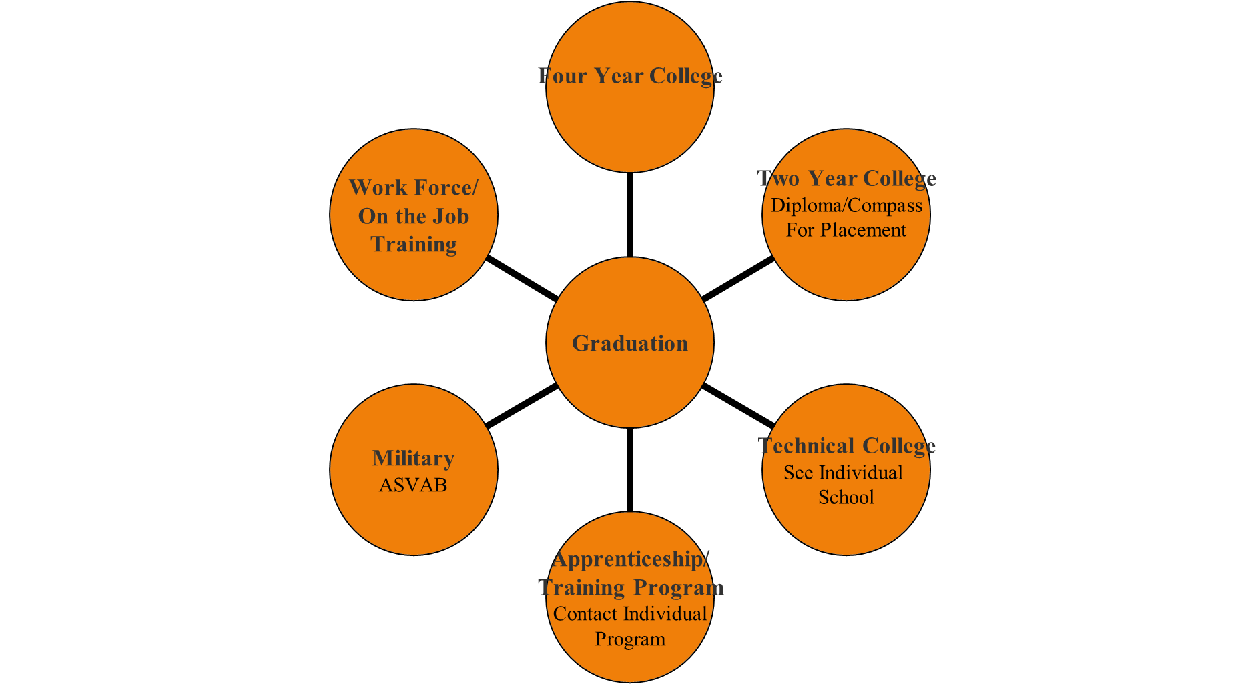
Post Secondary Options:

Slide 17


Not sure where to start?
Use Montana Career Information System!
Research Careers Financial Aid
Interest Inventories College Searches

Slide 18


Stay connected!
https://hhs.helenaschools.org/counseling-and-career-guidance/
Helena High Counseling
Instagram ~ Helena High Counseling
Facebook ~ Helena High Counseling

Slide 19
HHS Counseling Department
Mrs. Pandis A-G
Mrs. Staldine H-N
Ms. Rouse O-Z
Corena Hall Office Manager
Alexis Navarette Career Counselor

Slide 20
Graduation!
Saturday, June 7 at 11 AM
Carroll College

