Slide 1

Welcome Class of 2029!
#ProudToBeABengal
Materials due 3/7

Slide 2
Required Paperwork:
Attendance area determines what you need!
HMS/HHS attendance boundary
Out-of-district students
CRA/CHS attendance boundary
Outliers/unique situations

Slide 3
HMS Students (HHS Attendance Boundary)
Yellow HHS registration form
Blue health history
Jodi Neary 324-2214

Slide 4
Out-of-District Students (EVMS, Jefferson County and Broadwater County)
Refer to out-of-district checklist.
Out-of-district form requires supporting documentation.

Slide 5
CHS/CRA Attendance Area
In-district transfer request
  Approval by Brett Zanto, CHS Principal
  Approval by Brian Kessler, HHS Principal
Yellow HHS registration form
Blue health history

Slide 6
Outliers or Unique Situations
Students who live in the HHS attendance boundary but attend EVMS or Montana City or Clancy:
Yellow HHS registration form
Blue health history
HSD Enrollment Form
Request for Records

Slide 7

Why Helena High?
Advanced Academic Options (AP and Dual Credit)
Variety of Elective Opportunities
Experiential and Work-Based Learning
Clubs and Activities

Slide 8


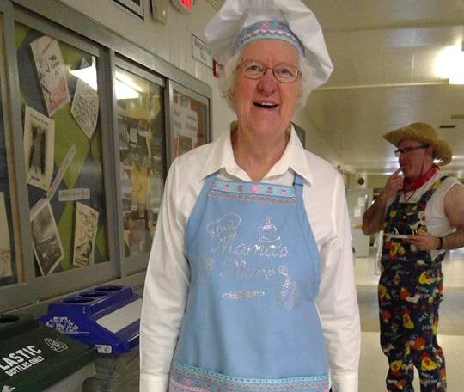

Why Helena High?
Talented educators and staff

Slide 9

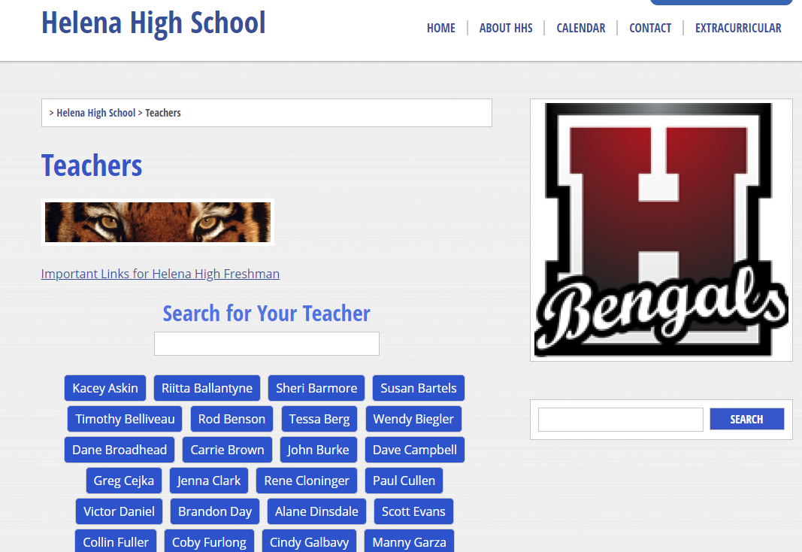

Resources
HHS Web Page hhs.helenaschools.org
Teacher and Dept. Pages
Extracurricular and camps
Counseling Department
HHS Counseling Facebook or Instagram
Call 324-2220
HHS App

Slide 10
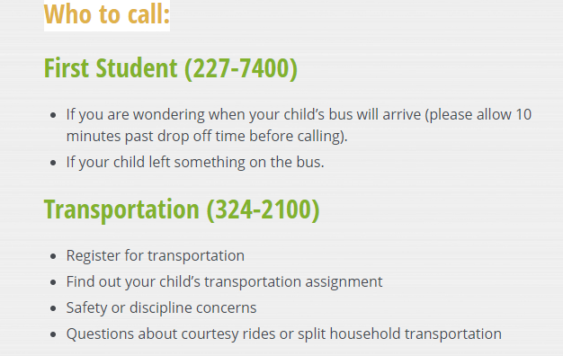
Transportation:

Slide 11

A student’s perspective on Helena High:
“There is something for everyone.”

