Slide 1
Welcome
Junior Parent Night
Helena High School

Slide 2
The Counseling Department
Last Name of Student:
A - G Mrs. Pandis 324-2227
H - N Mrs. Staldine 324-2224
O - Z Ms. Rouse 324-2223
Career Counselor Ms. Navarette 324-2225
Office Manager Corena VanDaele 324-2221

Slide 3
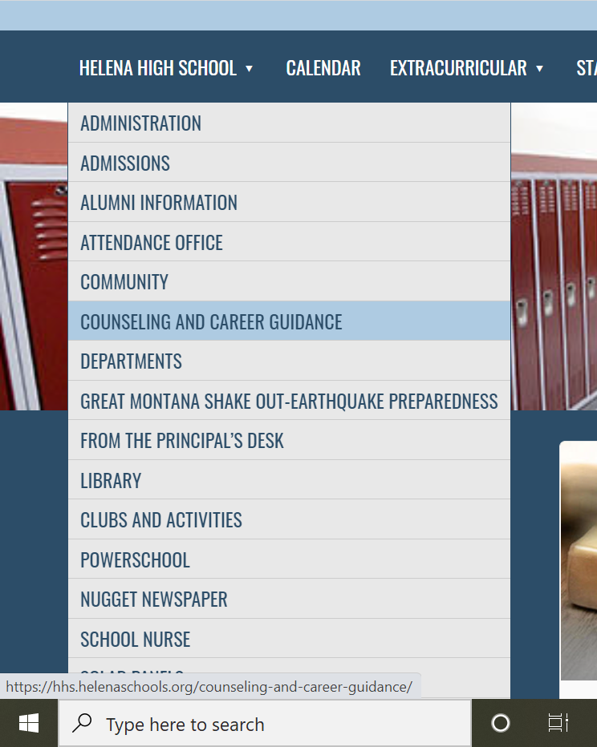

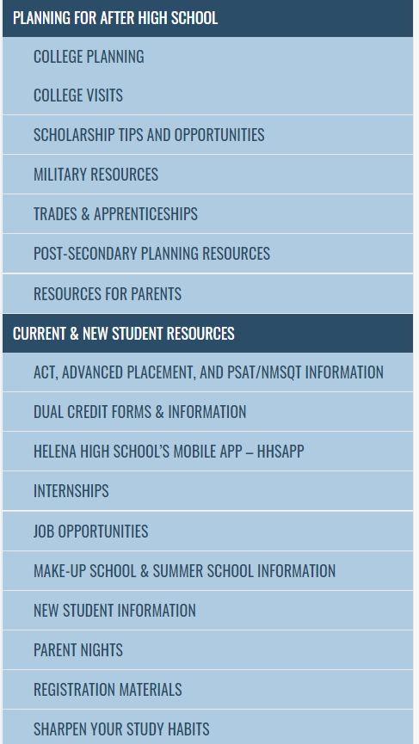
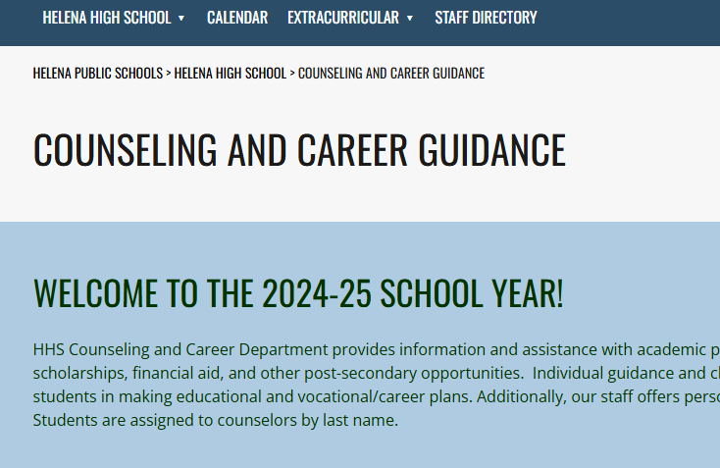

www.hhs.helenaschools.org

Slide 4
Junior Registration for Senior Year
Monday, March 10th
English classes -registration materials
Credit Check for Graduation
College Entrance Requirements
Friday, March 14th
English classes register in Library
Parent Signature Required

Slide 5
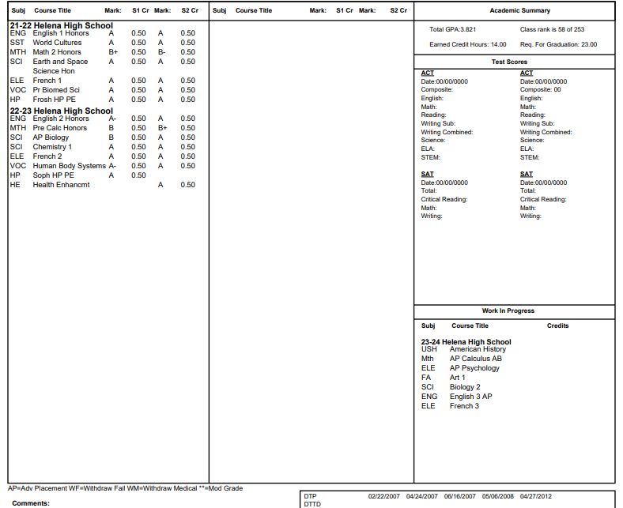
GPA &
Class Rank
Credits Earned
ACT, SAT, AP scores added upon request
Classes are coded to match Grad Req’s

Slide 6
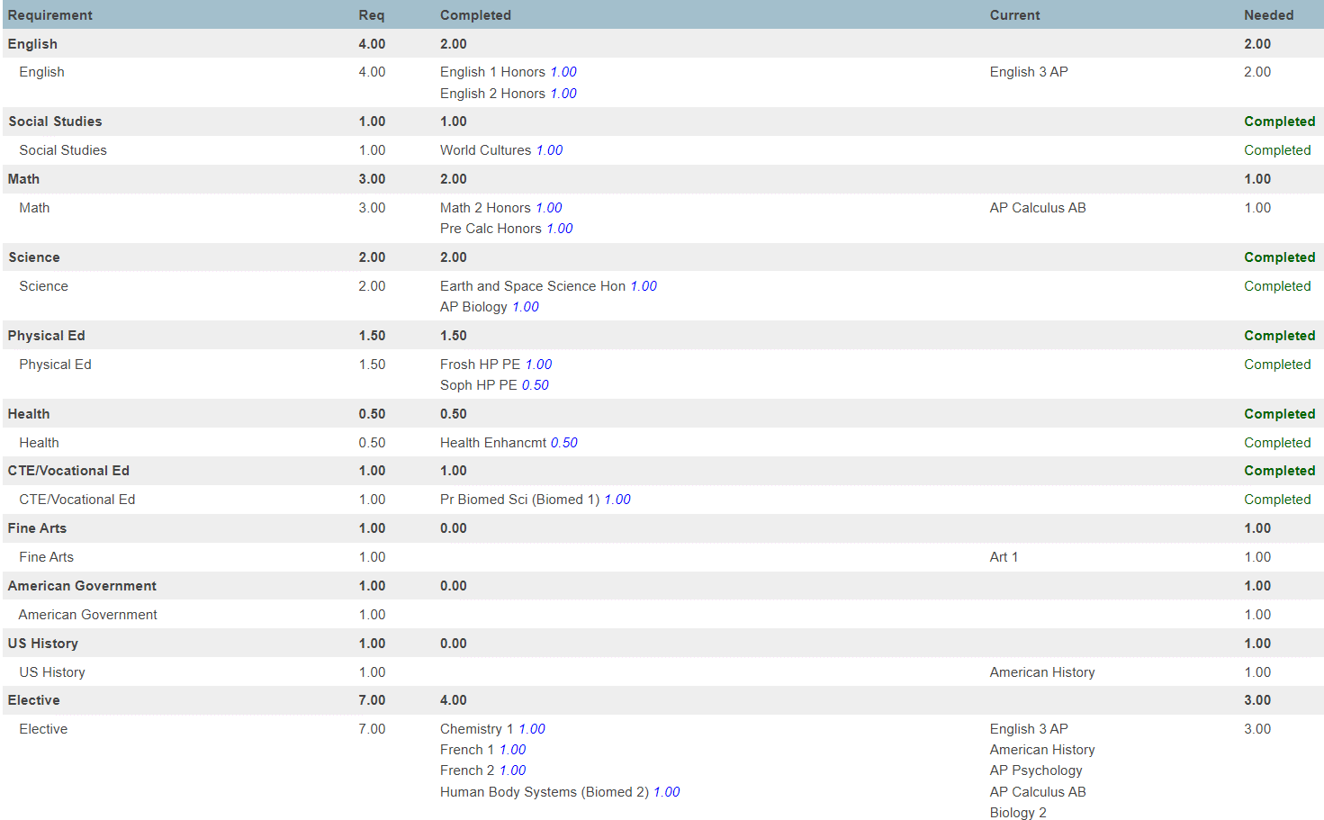

Slide 7

High School Graduation Requirements
  4 years of English 4 credits
  1 year of Social Studies (World Studies) 1 credit
  1 year of American Studies 1 1 credit
  1 year of American Studies 2 1 credit
  2 years of Science 2 credits
  3 years of Math 3 credits
  1.5 years of Human Performance 1.5 credits
  .5 year of Health 0.5 credit
  1 year of Fine Arts 1 credit
  1 year of Vocational (CTE) 1 credit
  Electives 7 credits
  Total 23 credits

Slide 8

Seniors are Required to take 6 credit-bearing classes
How to meet this requirement……
Fill your schedule with 6 or more HHS classes
  Study halls/TA’s are not considered credit-bearing classes
Take Business Co-Op
  Get credit for paid work experience!(Concurrent enrollment in vocational class req.)
Take a class at Helena College or Carroll College
Sign up for an internship
  Get credit for unpaid work experience!
Take a class online through MTDA
  Separate calendar and expectations, but may be an option
****Students are required to complete all graduation requirements at the end of senior year in order to participate in the graduation ceremony ****

Slide 9
MUS Admissions Requirements
(4-year campuses)
College Prep Curriculum:
  4 years of English
  3 years of Math
  2 years of Lab Sciences
  3 Years of Social Studies
  2 Years of College-Prep Electives (foreign language, computer science, visual and performing arts, or vocational units)
  *Interested in attending college out of state? Most colleges require 2 consecutive years of a foreign language and may have more specific requirements.

Slide 10

MUS Rigorous Core
4 years of English
4 years of Math (1 year beyond Algebra II)
3 years of Lab Sciences
3 Years of Social Studies
3 Years of College-Prep Electives
Must complete to be eligible for the MUS Honors Scholarship- 4-year renewable scholarship, waives tuition when used at eligible campus
http://mus.edu/Prepare/Pay/Scholarships/MUS_Honor_Scholarship.asp

Slide 11
MUS Admissions Standards (4-year campuses)
Must meet one of the following:
2.5 GPA
Rank in top ½ of class
Test scores:
  ACT 22 / SAT 1120 (MSU-B, MSU, UM, Tech, UMW)
  ACT 20 / SAT 1050 (MSU-N-Havre)
And……

Slide 12


MUS Admissions Standards
(Proficiency Standards)
Math Proficiency:
Writing Proficiency:
One of the following required:
-ACT math (22+)
-SAT math (27.5+)
-AP Calculus (3+)
-4 years of HS Math
(grade of C or above in Algebra I, Geometry, and Algebra 2 and 1 more beyond Algebra 2)
One of the following required:
-ACT ELA (18+)
-ACT Writing Test (19+)
-ACT Optional Essay (7+)
-SAT Writing/Language (25+)
-AP English Literature (3+)

Slide 13
ACT Test
When: April 8, 2025
Where: Helena High School
Students are automatically registered by the district with fees paid by Helena Public Schools.
Test format will be online
ACT scores can be used for college entrance, merit-based scholarships and/or dual credit class placement.
The ACT test gives students a good look at how prepared they are for college.
On average, students who retake the test their senior year increase their scores 60% of the time.

Slide 14
ACT Test Prep
  Watch for emails (from the district office) containing pertinent ACT info.
  ACT has free online test prep resources as well: ACT.org
  Quizlet has many free options for ACT prep as well: Quizlet Flashcards
    ACT Online Prep – purchased by the school district, students created their accounts during English classes. Access to 2 full practice tests as well as additional shorter tests/practice materials: ACT Online Prep
    Various FREE Online Study Options:
    ACT Student
    Test Prep Preview
    Number 2
    Princeton Review
    Khan Academy
    4 Tests

Slide 15
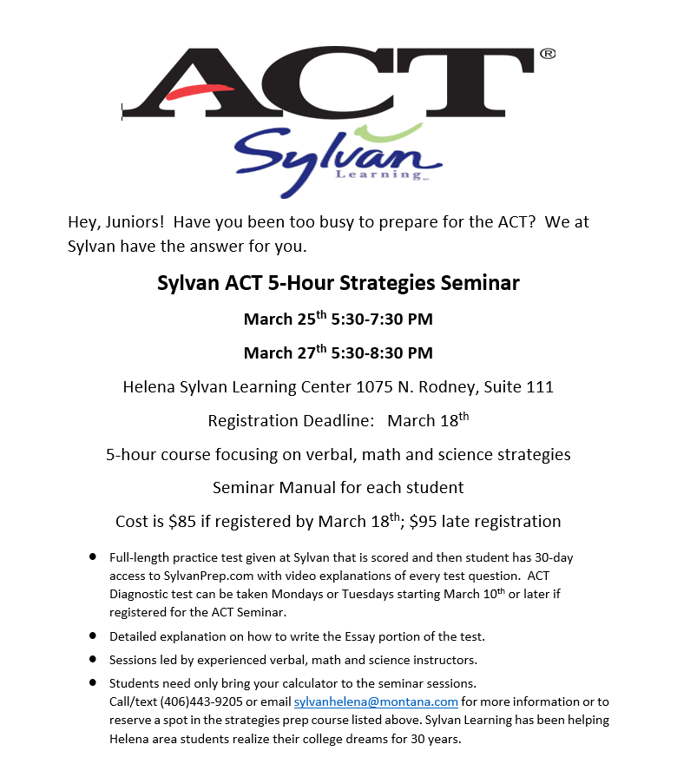
Sylvan Learning Center Reach out to Char Kautzman (406-443-9205 x1) for more info

Slide 16
Up Next:
Chrissy Rouse
324-2223
crouse2@helenaschools.org

Slide 17

Pros & Cons of Dual Credit
PROS
CONS
Earn H.S. Credit and College Credit at the same time
College level rigor
Helps students find right career path
Helps expedite college degree completion
Cost effectiveness – about 1/3 of the cost, may help save thousands (1-2-Free Initiative)
Lowers remediation rates
Free tutoring services at Helena College
Registration process – semesters don’t match up
Transferability of credits
Rigor of courses
Grades become permanent records on college transcripts

Slide 18



DUAL CREDIT COURSE LIST
Accounting | MS Word (Bengal Business CAPP 154) | MS Excel (Bengal Business CAPP 156)
College Writing | Intro to Literature | Communications in a Dynamic Workplace
Technical Math | Contemporary Math | Pre-Calculus
Calculus I | Calculus II | College Algebra
Intro to Statistics | CAD 2D (Drafting) – Gallatin College | Industrial Safety (Welding)
Culinary (Missoula College) | Intro to Psychology | Dual CREDIT vs Dual ENROLLMENT – What’s the difference?

Slide 19
Qualifying Factors for Dual Credit
No placement tests required (ACT/COMPASS)
Previous High School coursework (C’s or better)
Math placement form
Age Waiver / Teacher Recommendation

Slide 20

Paying for College Credit
Montana University System – 1-2-Free Initiative
* First two classes, up to 6 credits are free
* Dual Credit at HS or on College Campus
*Hardship Scholarship
*$55.92 per credit
One Two Free Info

Slide 21
Student Athletes
Clearinghouse required for all collegiate athletes.
Apply during Junior Year.
Requirements beneficial to know when registering
Make sure to let your counselor know that you are interested!

Slide 22
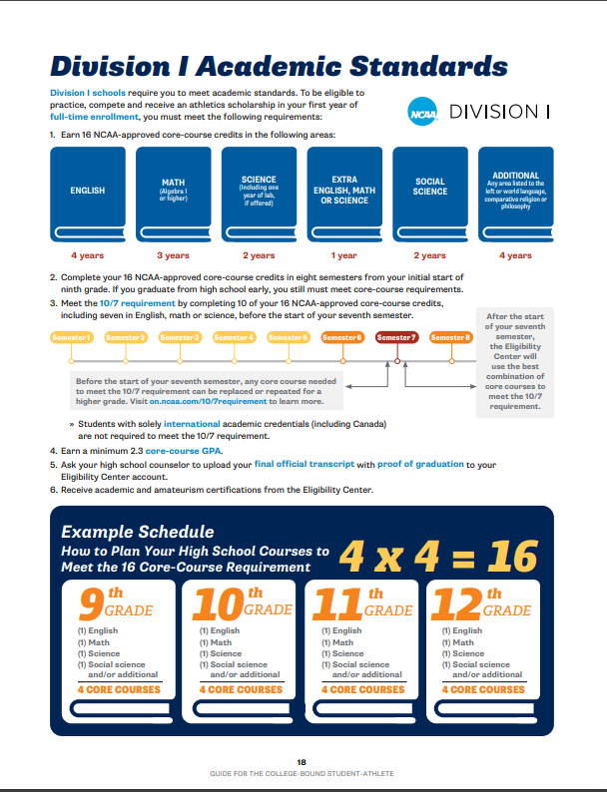

Register with NCAA
Eligibility
NCAA Portal

Slide 23
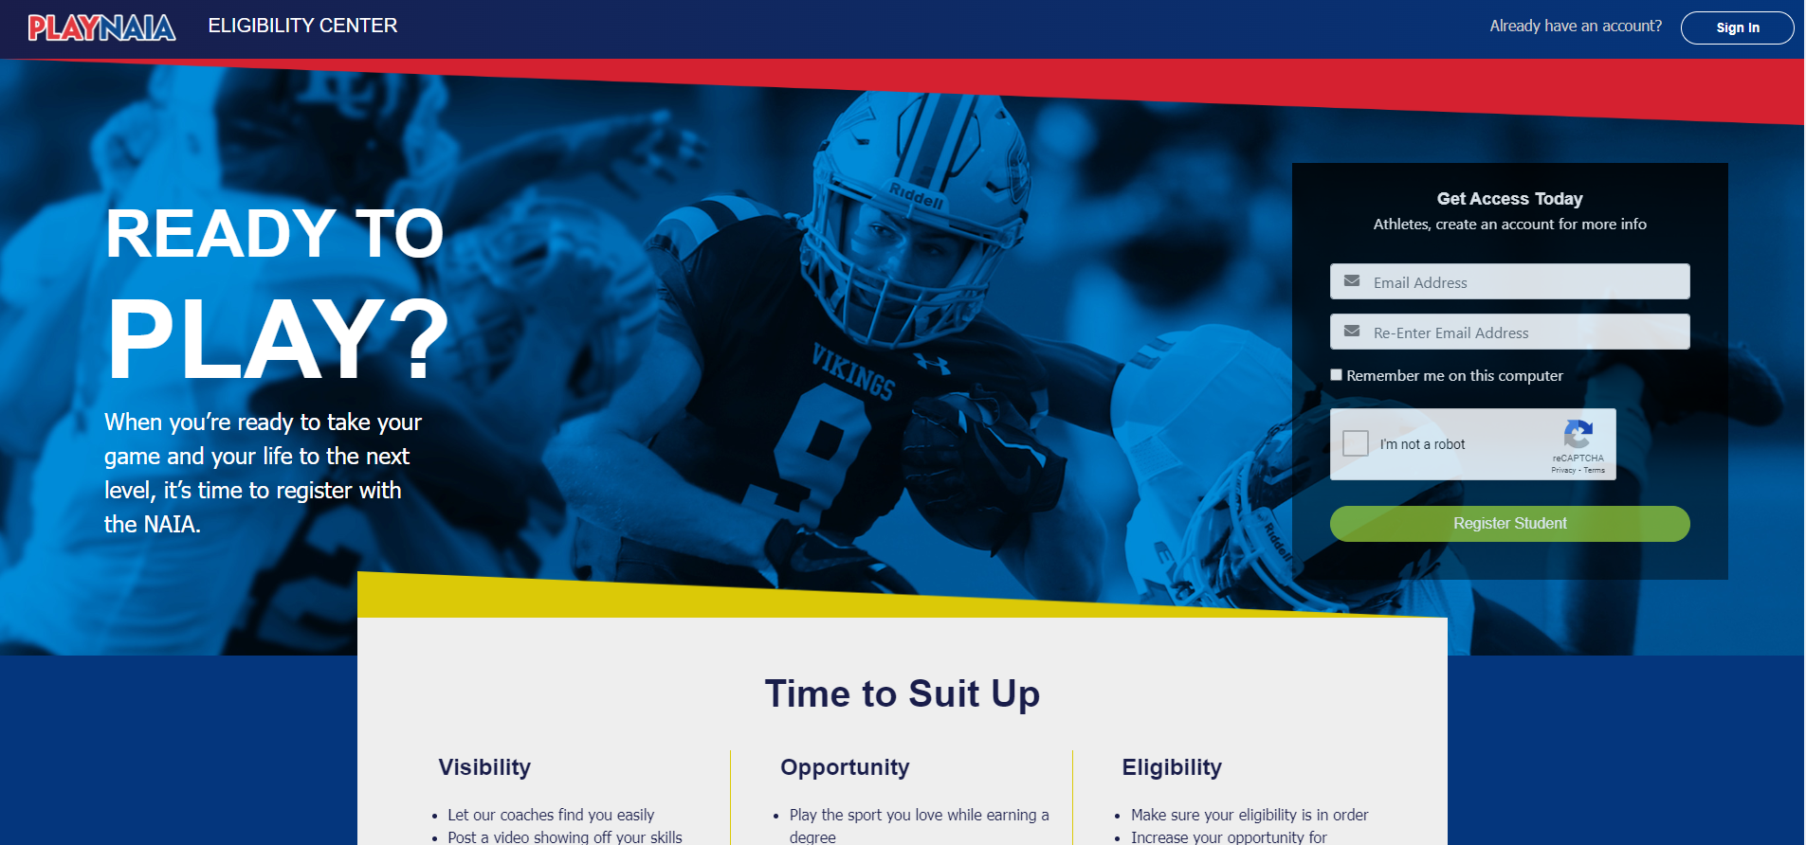
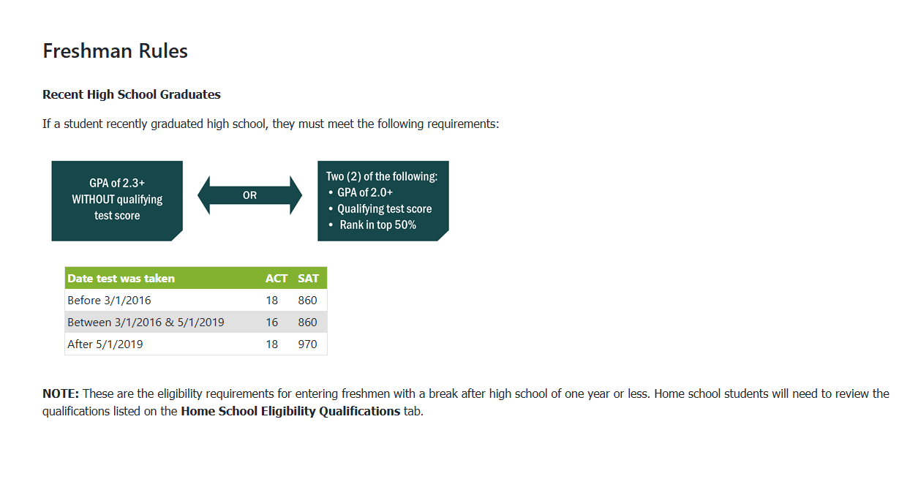
Register with NAIA Eligibility
Play NAIA Eligibility Center

Slide 24
Up Next:
Ellaina Staldine
324-2224
estaldine@helenaschools.org

Slide 25

Advanced Placement (AP)
•AP courses are rigorous, reflect what is taught in intro college courses.
•Students take optional AP Exams in May. Score well, earn college credit or advanced placement.
•Some courses are offered as both AP and dual credit.
Current AP offerings: • AP Chemistry • AP Language • AP Literature • AP US History • AP Government • AP Psychology • AP European History • AP Pre-Calculus • AP Calculus • AP Statistics • AP Biology • AP Human Geography • AP Environmental Science • AP Spanish 5 • AP Computer Science Principles • AP Computer Science A
Current AP students:
AP Exam registration DEADLINE is Friday at 3pm.
Exams take place between May 5-16th at HHS
        If there is a conflict with the exam date, contact AP Coordinator
        Doctor's note required for exams missed on testing day

Slide 26
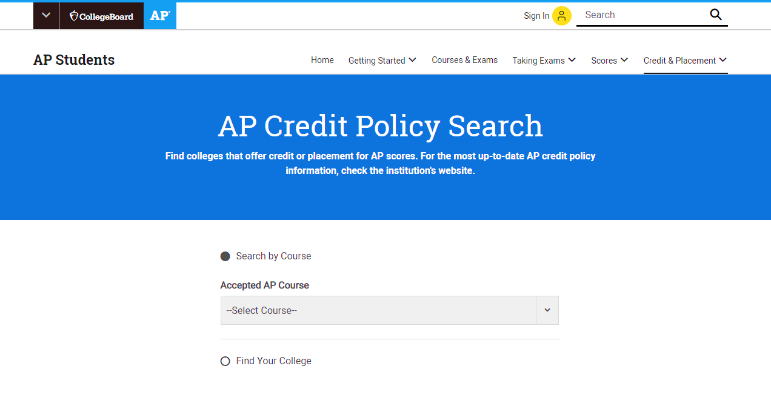
AP Credit Policy Search
Each college has its own policies regarding AP credits and placement. College Board offers a tool to find out how each college will count AP credits, and the exam score needed.
Visit: https://apstudents.collegeboard.org/getting-credit-placement/search-policies
Here is an example:
Montana State
• AP English Language- Score needed 4, Writing 101 (3 credits)
• AP English Literature- Score needed 3, Lit 110 (3 credits)
University of Montana
• AP English Language- Score needed 3, Writing 101 (6 credits)
• AP English Literature- Score needed 4, Lit 110 (6 credits)

Slide 27
PSAT/NMSQT Results
• Optional test administered digitally in October to 92 juniors.
• The PSAT measures the skills and knowledge that research shows are most essential for college/career readiness. Helps prepare for the ACT or optional SAT.
Scores available online thru College Board account or in the "BigFuture School" mobile app.
The average PSAT score is 920. Score range is 320-1520.
• A video demonstration (‘PSAT Score Report Tutorial’) and pdf (‘Understanding the PSAT Score Report) is available on our counseling website to assist you in understanding PSAT results.

Slide 28
Next Steps for Students
Create a College Board account to view full PSAT score report at psat.org/myscore
Create a Khan Academy account at satpractice.org and link it to your College Board account for free, personalized practice for the SAT/ACT
Download the BigFuture School Mobile app to see scores, plan for college and/or career, and to find scholarships.
Decide if you will register for the optional SAT or retake the ACT or both. Watch registration deadlines for both. See our counseling page under "Junior Parent Night" for info on ACT vs SAT.
Practice, practice, practice

Slide 29
National Merit Scholarship?
In general, students who score in the top 1% of juniors on the PSAT are deemed Semifinalists.
Typically, percentages in the 99th and sometimes 98th percentile are invited to compete (not guaranteed).
If invited, please know that your student needs to ‘verify’ their score by taking the ACT or SAT.
~ ACT National Test Dates: April 5th, June 14th, July 12th
(reminder: all Juniors will take the ACT at HHS April 8, 2025)
~ SAT National Test Dates: May 3rd, June 7th

Slide 30
Up Next:
Alexis Navarette
324-2225
anavarrete@helenaschools.org

Slide 31
Jr. Year tasks
Academic success
Get involved (join a club/volunteer)
Job Shadows/Internships
College & Military Visits
Scholarships
Register for ACT/SAT if desired:
~ ACT National Test Dates: Apr 5th , June 14th , July 12th
(reminder: all Juniors will take the ACT at HHS during April 8, 2025)
~ SAT National Test Dates: May 3rd , June 7th
(reminder: SAT testing is ONLY available in digital format; students who need to borrow a device from College Board will need to register and request their device earlier than the registration deadline – at least 30 days before test day)

Slide 32

Montana Career Information System (MCIS)
Excellent resource for college and career research!
There are so many useful tools with MCIS including career interest inventories and scholarship search tools.
Counselors will be providing instruction on the use of MCIS to Juniors this Spring.
Students can log in using Clever (on school district device) or by creating account at: MCIS login

Slide 33


College & Military Visits
Going there:
Staying here:
Parents excuses student prior to absence.
Obtain written verification from college officials and give it to HHS attendance.
  Absence will be changed to school related.
  * Allowed 2 per year
Listen to the bulletin, check bulletin online, check the counseling office website.
Sign-up ahead of time in the counseling office.
Counseling will send a pass to attend.

Slide 34

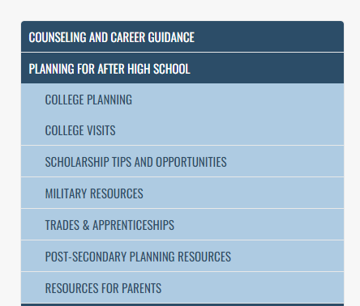
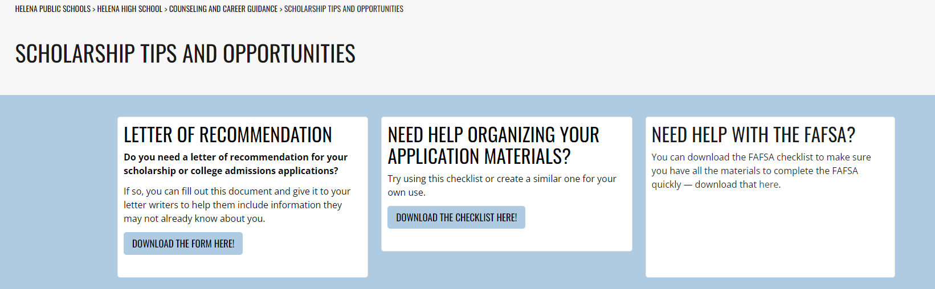


Scholarship Resources
Helena High Scholarship List
College Green Light
Fast Web
Ms. Navarrete!

Slide 35
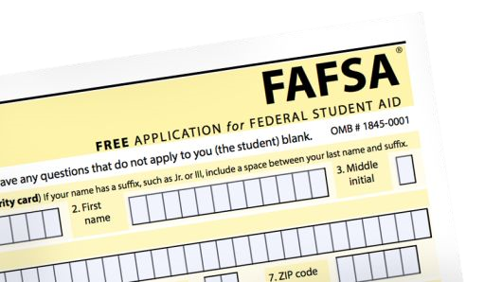
FAFSA
Historically, parents have been able to submit the FAFSA beginning October 1st each year, however the past two years have seen the federal government adjust the start date to the beginning of December. As with all new things, there is a learning curve – you’ll want to attend senior parent night next Fall for the most current/updated info about FAFSA
Must have an FSA ID prior to starting the application.
  Student obtains FSA ID first, and then invites parent to join FAFSA process (via email link)
  Go to fafsa.gov for more information.

Slide 36
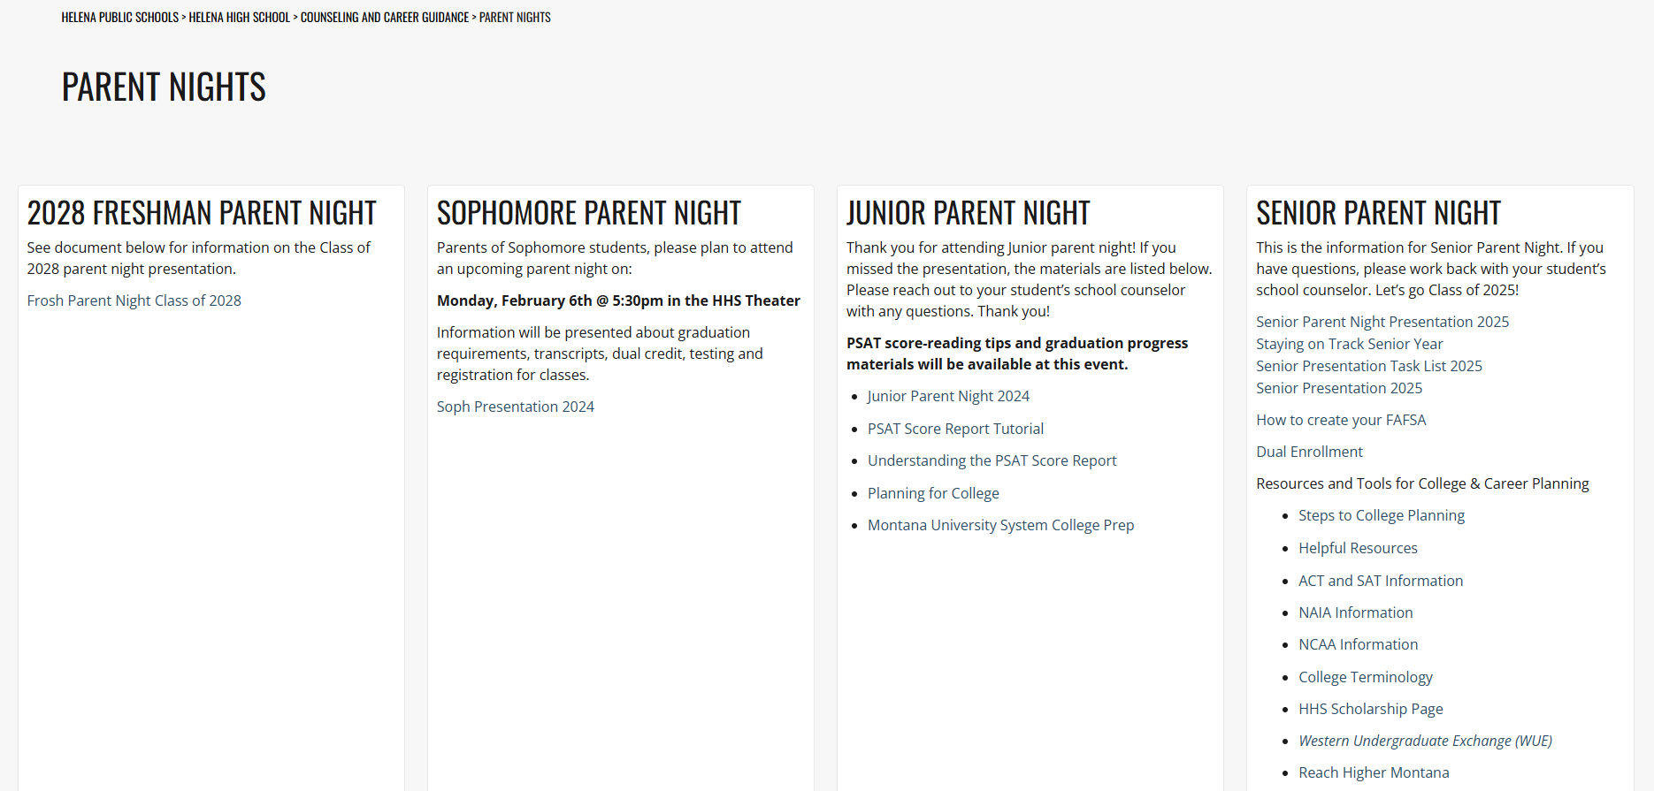
Parent Night Resources

Slide 37


Stay Connected!
Web Page- www.hhs.helenaschools.org
Facebook- Helena High School Counseling Department
Instagram – bengal_counseling

Slide 38
Thanks for coming!
Questions?
See your student’s counselor

