Slide 1

SENIOR YEAR: 101
Class of 2027

Slide 2

HHS Counseling Department
Mrs. Howard-Murphy (A-G) 324-2227
Mrs. Bermingham (H-N) 324-2224
Mr. Michaud (O-Z) 324-2223
Miss Terri (Social Services Coordinator) 324-2218
Mr. Troyer (Career Resource) 324-2225
Corena VanDaele (Office Manager) 324-2221

Slide 3

Linden Howard-Murphy
Counselor: A-G
(406) 324-2227 lhowardmurphy@helenaschools.org

Slide 4
Postsecondary Options…
(Graduation is the start, not the finish!)
Apprenticeships
“Earn while you learn”
Paid, hands-on training
Path to skilled trades careers (electrician, plumber, carpenter, etc.)
US Military​
ASVAB placement test ​​
Career training & leadership development
Tuition assistance & GI Bill benefits​​
Workforce/On-the-Job Training ​​
Immediate employment ​​
Employer-provided training
Opportunity to build work experience​​
Gap Year​
Time for travel, work, volunteering, or personal development ​​
Explore interests before further education or career ​​
4-Year College
Bachelor's Degree
Wide career opportunities ​
Scholarships & financial aid available ​
Many schools now **test-optional**​
Two-Year College ​
Associate’s degree (2 years) ​
Lower tuition, transfer pathways to 4-year colleges ​
Career-focused certificates​
Technical/Trade School ​
6 months–2 years ​
Career-specific training (healthcare, IT, mechanics, cosmetology, etc.) ​
High job placement rates​

Slide 5
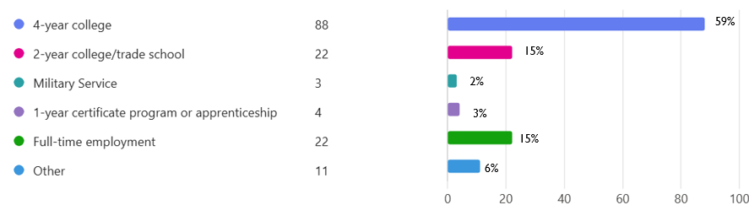
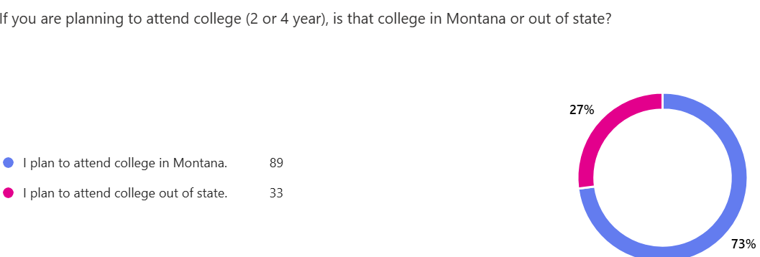
Class of 2025 End Of Year Survey
The class of 2025 continued the increasing trend of more students starting at 2- year schools. The majority who attend 4-year schools, chose to stay in Montana.
Students are being more aware of debt and costs of attendance when making decisions.

Slide 6
ACT & SAT Placement Information:
ACT/SAT are college admission exams for 4-year institutions
Since the pandemic, ACT/SAT scores have become optional at many universities around the country
However, consideration for merit-based scholarships MAY require ACT or SAT scores. (Montana University Honors Scholarship).
Math and Writing Placement: (for college course placement)
ACT 22 or SAT 27.5 Math subtest
ACT writing test 7 or ELA 18; SAT 25

Slide 7


Slide 8
ACT Prep for a retake
**ACT Exam Prep- Sylvan Learning Center is offering an ACT Prep course for students who want to improve scores and retake the ACT in December.
The ACT Prep course will give students a full year access to SylvanPrep.com when they enroll in the in-center instructional sessions. The course includes two manuals (Verbal skills and Math/Science) as well as 4 practice tests which can be completed during the in-center prep (2 practice tests) and the others at the student’s convenience.
ACT Prep beings on Thursday, September 18th 4:30-6:30 and Tuesday, September 23rd 4:30-6:30.
Contact/registration: Char Kautzman (406)443-9205

Slide 9

Looking out-of-state?
Tools to consider:
WUE (Western Undergraduate Exchange Program): Student pays no more than 150% of in-state tuition.
Questbridge: High achieving, low-income students; 4 year full-tuition to a partner school). Income threshold, less than $65,000. National College Match application due by 10/1/2026.

Slide 10
CRISTIN BERMINGHAM
COUNSELOR: H-N
(406) 324-2224
CBERMINGHAM@HELENASCHOOLS.ORG

Slide 11

Advanced Placement (AP)
AP exams offer the opportunity to earn college credit
Students take the optional AP Exam in May
Instructions on how to register/pay for an AP exam have been in the Bengal Happenings
  AP teachers give students their AP join codes
  Students log into their College Board AP account to join
  Payment of $40 per exam is made in Revtrak by Nov. 14th. ($40 late registration or drop fee beginning Nov. 15th date)
  Prefer to have student seat secured by October 1, 2026
Exams take place between May 3-14, 2027.
  If there is a conflict with the exam date, contact AP Coordinator.
  Doctor's note required for exams missed on testing day

Slide 12
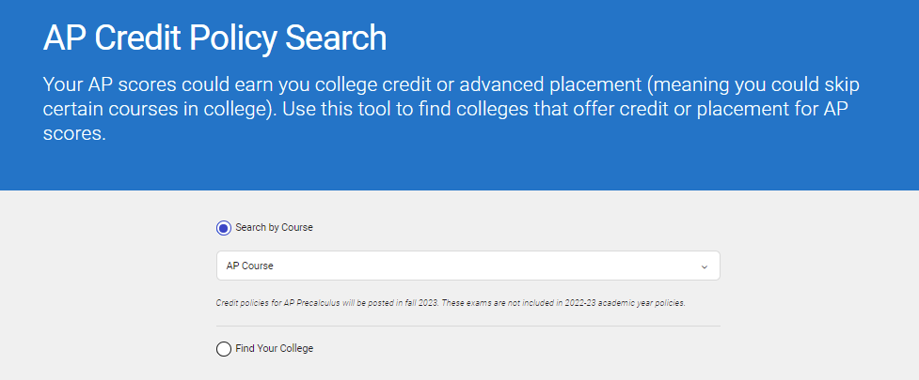
AP Course Transfer Credits
Each college and university has its own policies regarding AP credits and placement. College Board offers a tool to Find out how each college will count AP credits, and the exam score needed.
Visit: https://apstudents.collegeboard.org/getting-credit-placement/search-policies
An example:
Montana State
AP English Language- Score needed 4, Writing 101 (3 credits)
AP English Literature- Score needed 3, Lit 110 (3 credits)
University of Montana
AP English Language- Score needed 3, Writing 101 (6 credits)
AP English Literature- Score needed 4, Lit 110 (6 credits)
**To get credit/placement for AP scores, students must request an official AP score report using their College Board account.
If taking an exam this year- deadline to request a free score report is June 20th

Slide 13
Joe Michaud
Counselor: O-Z
(406) 324-2223 jmichaud@helenaschools.org
7

Slide 14

High School Graduation Requirements
  4 years of English 4 credits
  3 years of Social Studies 3 credits
  (World Studies, American Studies I, American Studies II)
  2 years of Science 2 credits
  3 years of Math 3 credits
  1.5 years of Human Performance 1.5 credits
  .5 year of Health 0.5 credit
  1 year of Fine Arts 1 credit
  1 year of Vocational (CTE) 1 credit
  Financial Literacy .5 credit **
  **(Incorperated into AS1 and AS2 classes.)
  Electives 7 credits
  Total 23 credits

Slide 15
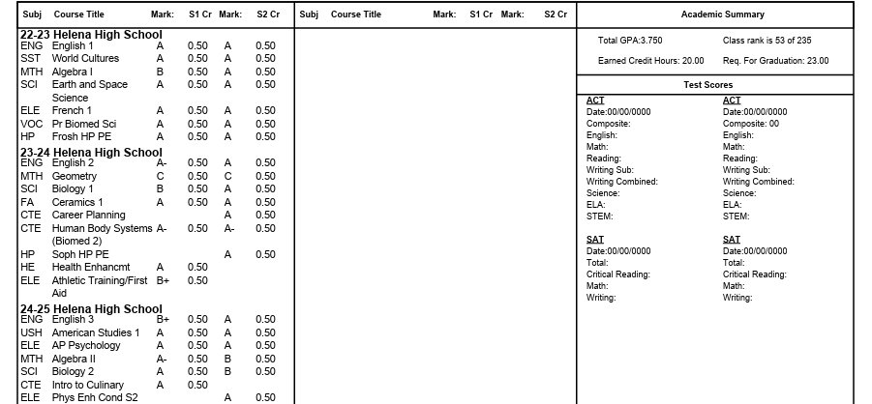
Understanding the Transcript
GPA &
Class Rank
Credits Earned
Classes are coded to match Grad Req’s
ACT/SAT scores added upon request

Slide 16
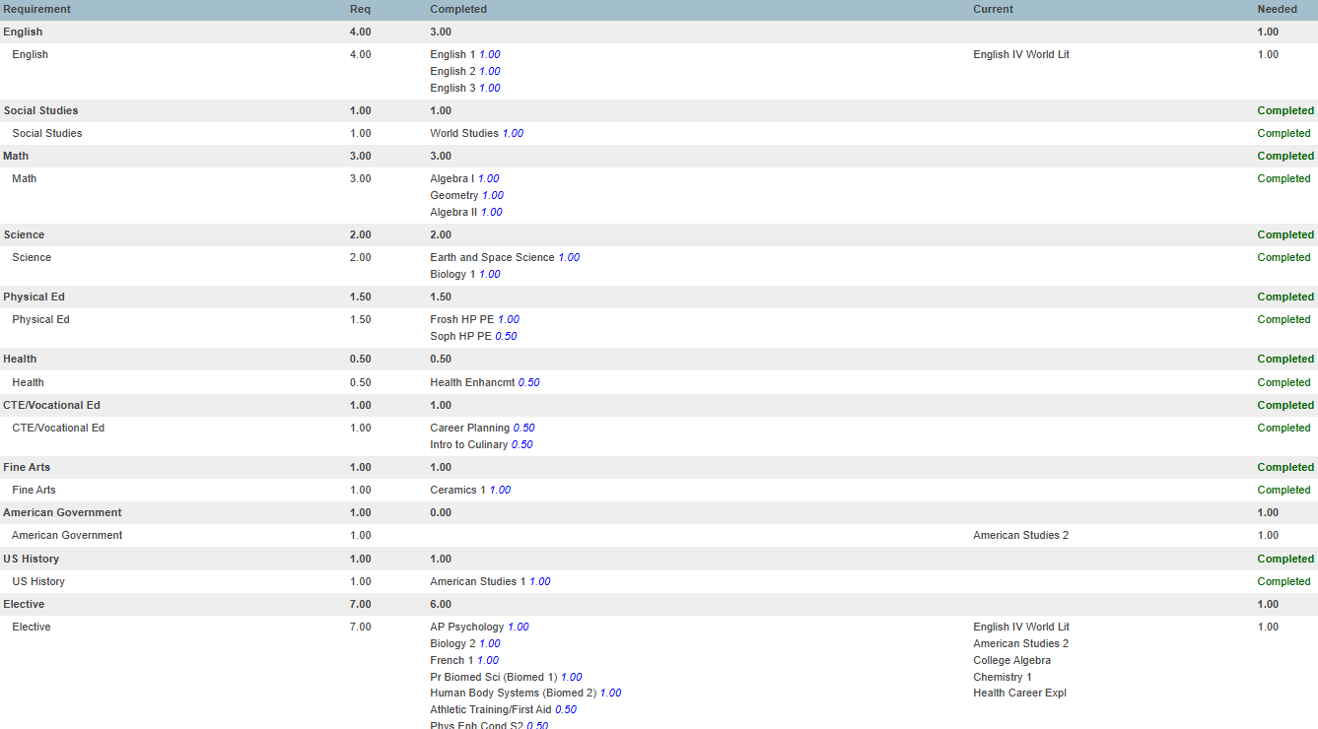
Graduation Progress

Slide 17

Is your Legal NAME correct on your transcript?
Does it match your driver’s license/birth certificate?
The name on your transcript will be the name on your diploma.
Helena High Diploma

Slide 18
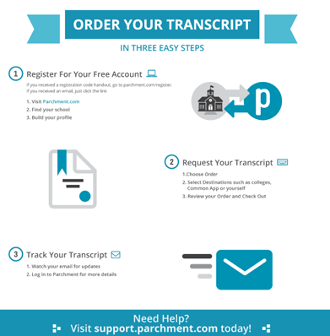
Transcript Requests
​
  Helena High will send your transcript for free and unlimited while a student at HHS using Parchment. After graduation, transcripts cost $10 each. Create an account to request transcripts for colleges, military, and scholarships.​ Step by steps directions in your Senior Teams!
  Don’t forget other transcripts/score reports- AP scores from College Board, Dual Credits from the awarding institution, NCAA/NAIA portal, ACT/SAT scores.
https://www.parchment.com/

Slide 19




Dual Credit:
Dual Credit Forms & Information | Helena High School (helenaschools.org)
* Registration took place for fall on 9/10 & 9/11
* One, Two, Free
- students can take two classes up to 6 credits for free
* approximately $60.00 per credit after 6 free credits
* 15 courses offered at HHS for DC through Helena College
* In addition, DC courses offered in drafting through Gallatin College, culinary through Missoula College and MSU, personal finance through Miles City College, and business through University of Iowa. Welding through MSU-Northern.

Slide 20



Slide 21

Yearbook Photo & Ads
Senior Pictures Due: October 31, 2026
Save image as Last Name, First Name (SmithAnna)
Email to Ms. Walsh mwalsh@helenaschools.org
Personal Ads Due: January 1, 2027

Slide 22
TERRI STOTTS
SOCIAL SERVICES COORDINATOR
(406) 324-2218
TSTOTTS@HELENASCHOOLS.ORG

Slide 23


Slide 24
jake troyer career resource assistant
(406) 324-2225 jtroyer@helenaschools.org

Slide 25
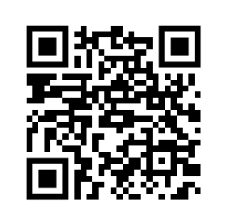
College & Career Fair:
September 28, 2026
Carroll College 1-3pm
Scan the QR Code or
Click here to Register Online to Participate

Slide 26
College Application Week
October 5 - October 16, 2026
Periods 6-7 in the Library Computer Lab
Get assistance with college admissions applications.
Student can apply to all public colleges in Montana for FREE! Anytime!
Must use the Apply Montana Application to get the application fee waived
By appointment (October 7th-11th) with Mr. Troyer

Slide 27
College & Recruiter Visits:
Going there:
(Allowed 2 per year)
1. Parent excuses student prior to absence.
2. Obtain written verification from college official and give to HHS attendance. Absence will be changed to Extenuating.
At HHS:
Know who is coming.
  Teams, Counseling Center bulletin board
  Read during nutrition break announcements
2. Sign-up ahead of time in Counseling Center or fill out the form online.
3. Counseling Center will send pass to attend.

Slide 28
APPLY montana
Applymontana.mus.edu
Complete one FREE application to apply to multiple Montana University System campuses at the same time.

Slide 29

F
(Free Application for Federal Student Aid)
Why FAFSA?
This is how you get a student loan or grant.
Required for certain scholarship applications.
FAFSA- Free Application for Federal Student Aid
Why FAFSA?
This is how you get a student loan or grants (free $$$)
Required for certain scholarship applications.
Step One: Create an account at studentaid.gov. The student and one parent/guardian will need a username and password.
Step Two: Complete the FAFSA application online.
**Student begins application first and invites the parent. Parent receives invite email.
Important Dates:
October 1st- FAFSA Opens
December 1st- FAFSA priority deadline
Click here to access the FAFSA site.

Slide 30
FAFSA Process
1. Fill out & submit FAFSA
(Studentaid.gov)
2. Federal processor will determine SAI (Student Aid Index)
3. School receives FAFSA information
4. School determines need
5. School creates financial aid offer
6. Student receives offer letter
7. Student responds to aid offer

Slide 31


Slide 32
Scholarships
(2-year, 4-year, trade schools, and special programs)
Scholarships are available to every student…no matter their GPA!
Get organized. Research scholarships you’re eligible for and keep a list, set time aside every week to work on scholarships.
Start close to home. Most likely, there will be fewer applicants for local scholarships than national scholarships.
Apply early for scholarships offered by the campus you plan to attend. Campuses offer many scholarships to incoming freshmen.
Scholarship search tools and services:
Helena High Scholarship List- online (click the link to access the page)
Reach Higher Montana
Level All

Slide 33
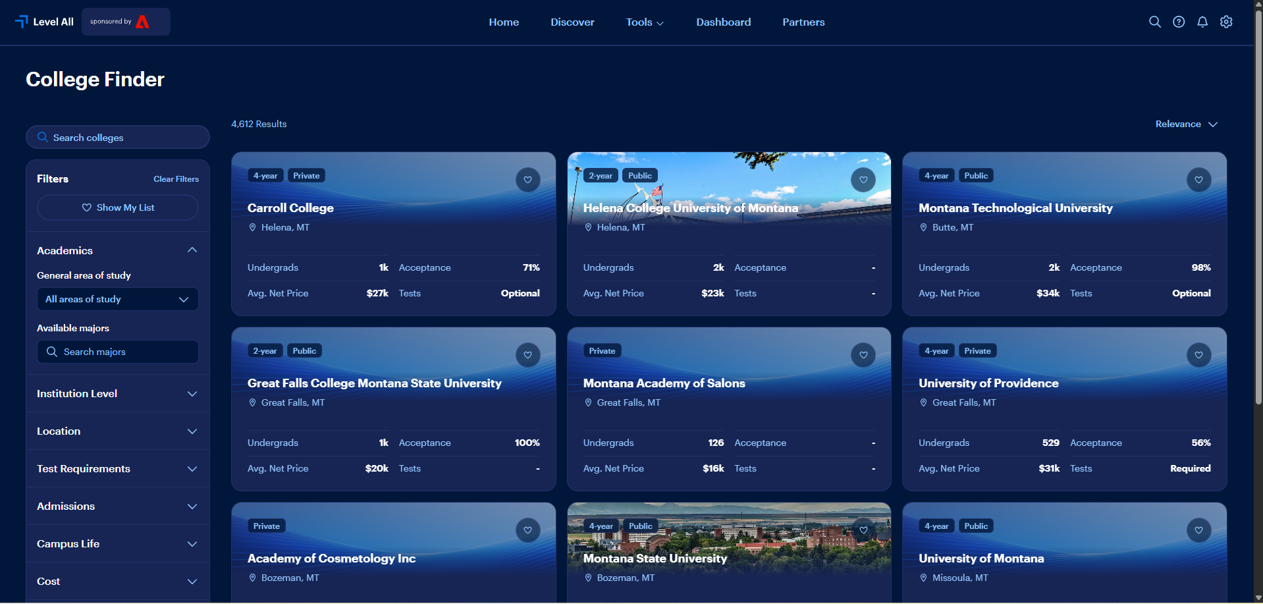

Slide 34
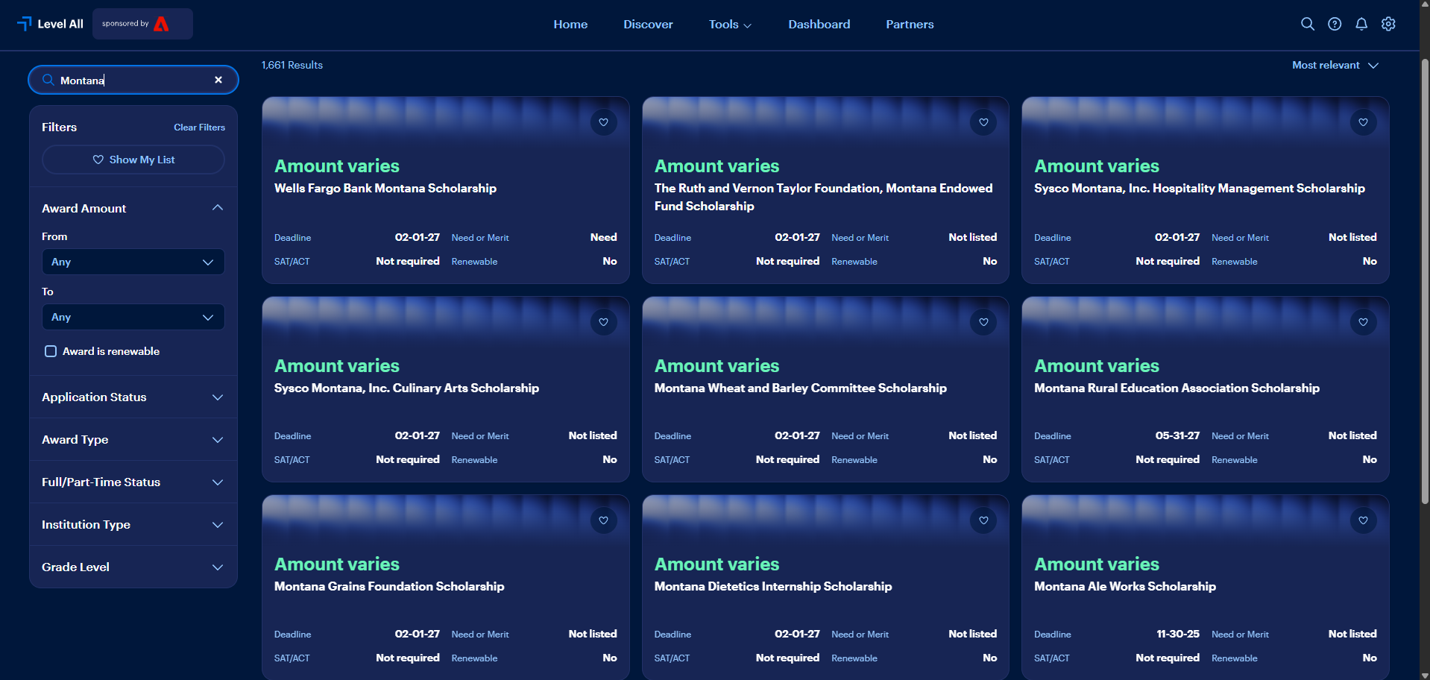

Slide 35


Stay Connected!
Senior TEAMS Page
Web Page- www.hhs.helenaschools.org
Facebook- Helena High School
Instagram – @helenahighschoolbengals
Bengal Happenings

Slide 36

GRADUATION!!!
Saturday, June 5th
11:30 AM
Carroll College

